Slide 1
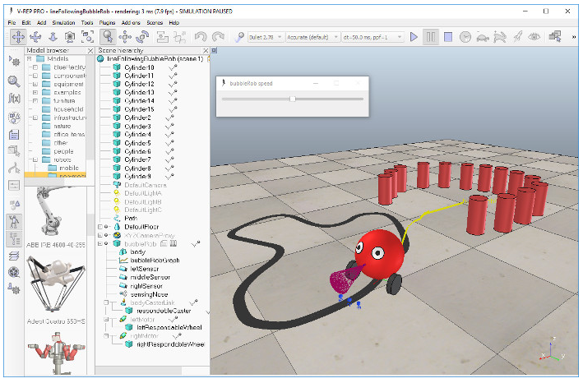
Introduction
Learning of supplied material:
Manual;
Program commands;
Lua language;
Tutorials;
Robot componentes;
Robot Script.
Finding problems:
Getting to the line;
Box contour;
Goal stop;
Leaving the course.
Figure 01: Line following BubbleRob tutorial
Source: V-Rep Manual
BIR Challenge
Breno Miranda Portela

Slide 2
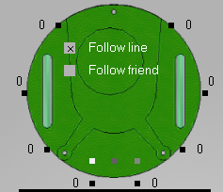
Development
If all light sensors show near values, spin the robot counterclockwise;
Use of console command Windows to check values;
Max speed reduced;
Use of proximity sensors to improve box contour;
Use of simulation timing to define the goal’s stop.
7
8
6
1
Figure 02: ePuck layout sensors
1
2
3
2
5
4
3
BIR Challenge
Breno Miranda Portela

Slide 3
Achievements and learning
Robot can contour the box;
Robot can finish the course, stoping on goal;
Robot can recognize the line to follow;
Solutions with low knowledge;
A new program and program language learned.
BIR Challenge
Breno Miranda Portela

